Slide 1

Sales Report And Future Goals
TOWARDS NEW HORIZONS: SALES REPORT AND UPCOMING TARGETS

Slide 2
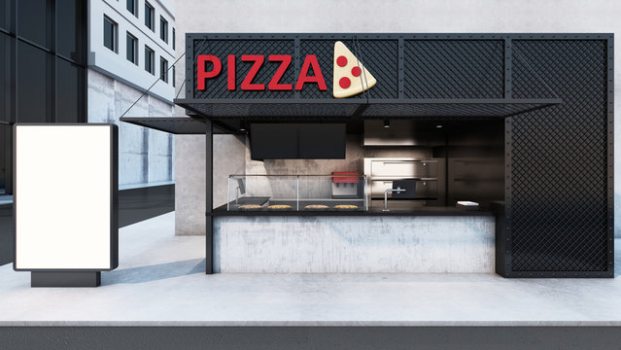
Introduction to the sales report
This script is designed to create a comprehensive sales report for a pizza restaurant using SQL. The report
includes various analyses such as total orders, revenue, most popular pizzas, and order distribution over time.
The following queries are used to extract and aggregate data from the PIZZA database.

Slide 3

Sales report methodology
The following methodology outlines the steps and SQL queries used to generate a comprehensive pizza sales report for the PIZZA_HUT database. The report aims to provide insights into sales performance, popular
products, revenue distribution, and ordering patterns.

Slide 4
Step 1: Create and Select Database
Step 1: Create and Select Database
CREATE DATABASE PIZZA_HUT;
Use Database: The script switches to the PIZZA_HUT database to perform subsequent operations.
USE PIZZA_HUT;

Slide 5
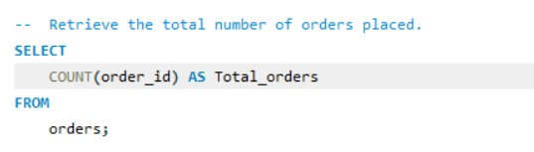

Total Orders: Count the total
number of orders placed

Slide 6
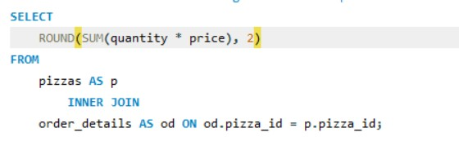

Calculate the total revenue
generated from pizza sales.

Slide 7
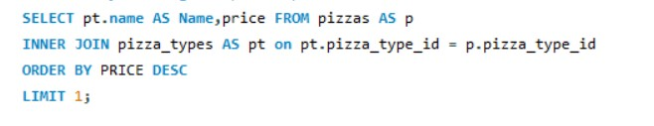
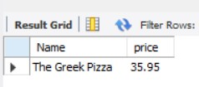
Identify the highest-priced
pizza.

Slide 8

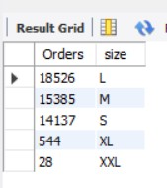
Identify the most common
pizza size ordered.

Slide 9
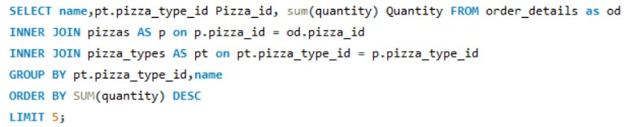
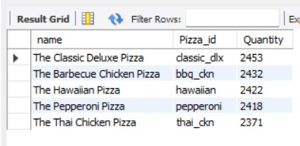
List the top 5 most ordered pizza
types along with their quantities.

Slide 10
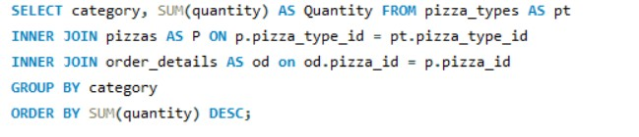
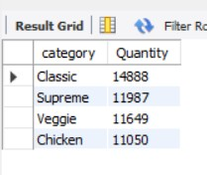
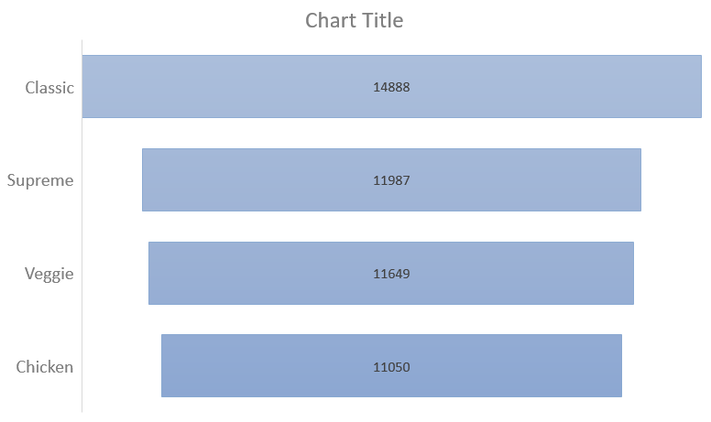
Intermediate:
Join the necessary tables to find the total quantity of each pizza category ordered.

Slide 11

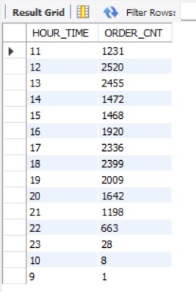
Determine the distribution of orders by
hour of the day.

Slide 12

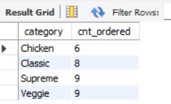
Join relevant tables to find the category-
wise distribution of pizzas.

Slide 13
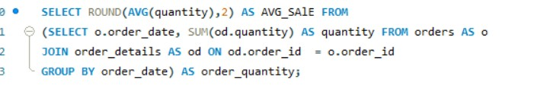

Group the orders by date and calculate the
average number of pizzas ordered per day.

Slide 14
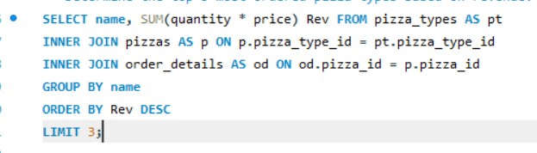
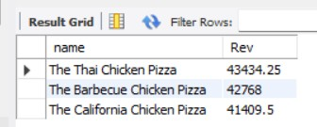
Determine the top 3 most ordered pizza
types based on revenue.

Slide 15
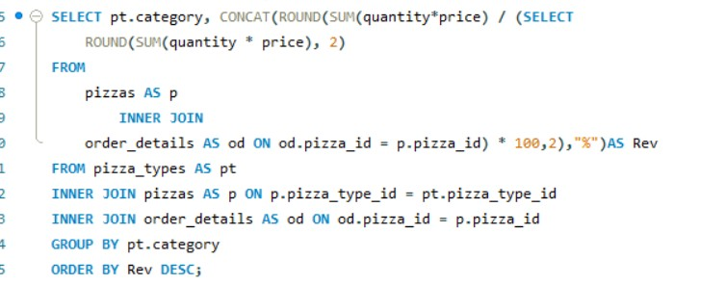
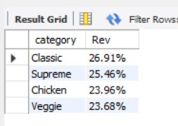
Advanced:
Calculate the percentage contribution of each pizza type to total revenue.

Slide 16
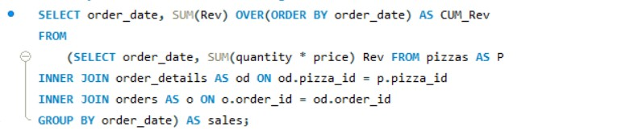
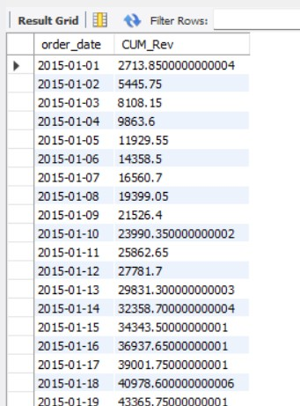
Analyze the cumulative revenue generated over time.
25 Result

Slide 17
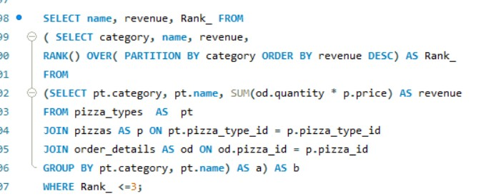
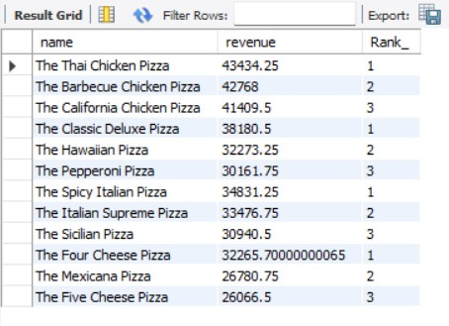
Determine the top 3 most ordered pizza types
based on revenue for each pizza category.

